Slide 1

DHANALAKSHMI SRINIVASAN COLLEGE OF ENGINEERING AND TECHNOLOGY
PROJECT FIRST REVIEW
SANTOSH KUMAR (310520104111) RAMESH GIRI (310520104096) VIVEK CHAUHAN (310520104140) RANJIT KUMAR (310520104098) GUIDED BY
Ms Priyadharshini
GUIDED BY
DEPARTMENT OF CSE
DEPARTMENT OF INFORMATION TECHNOLOGY

Slide 2
DHANALAKSHMI SRINIVASAN COLLEGE OF ENGINEERING AND TECHNOLOGY
DOMAIN: Artificial Intelligence
TITLE: AUTOMATED RESTAURANT FEEDBACK SYSTEM USING FACIAL EXPRESSION ANALYSIS
DEPARTMENT OF CSE
DEPARTMENT OF INFORMATION TECHNOLOGY

Slide 3
OBJECTIVE
The objective of this project is to design and implement a system that can automatically collect feedback from customers in restaurants based on their facial expressions using deep learning techniques. The system should be able to capture the faces of customers from images or videos, detect and recognize their emotions, and generate a feedback score that reflects their satisfaction level. The system should also be able to handle various challenges such as occlusion, illumination, pose, and expression variations. The system should be evaluated on a dataset of restaurant images and compared with the manual ratings given by human annotators.
DEPARTMENT OF CSE
DEPARTMENT OF INFORMATION TECHNOLOGY

Slide 4
ABSTRACT
Facial expression analysis offers a promising avenue for automated restaurant feedback systems. In this project, we propose a novel application of deep learning techniques to capture and interpret customer satisfaction levels in restaurants. Our approach employs a two-stage deep learning architecture, utilizing a pre-trained convolutional neural network (CNN) for facial feature extraction and a recurrent neural network (RNN) for emotion classification as a named of proposed work called Facial Expression Analysis using Deep Learning (FEA-DL). The system categorizes facial expressions into six primary emotions: happy, sad, angry, surprised, disgusted, and neutral. By training on a comprehensive dataset of diverse facial expressions annotated with corresponding feedback scores, our system can provide real-time feedback on customer satisfaction levels. Integrated into existing customer feedback mechanisms, such as mobile applications or service interfaces, this system enables restaurant owners to make data-driven decisions to enhance service quality and overall customer experience. This project underscores the potential of facial expression analysis and deep learning in revolutionizing hospitality industry practices
DEPARTMENT OF CSE
DEPARTMENT OF INFORMATION TECHNOLOGY

Slide 5
EXISTING SYSTEM
As there is no staff available in unmanned restaurants, it is difficult for the restaurant management to estimate how the concept and the food is experienced by the customers. Existing rating systems, such as Google and Trip Advisor, only partially solve this problem, as they only cover a part of the customer’s opinions. These rating systems are only used by a subset of the customers who rate the restaurant on independent rating platforms on their own initiative. This applies mainly to customers who experience their visit as very positive or negative
DISADVANTAGE:
Anonymous reviews posted on independent rating platforms will often lead to a mixed perception on the restaurants making it hard to decide its genuinely
This applies mainly to customers who experience their visit as very positive or negative
DEPARTMENT OF CSE
DEPARTMENT OF INFORMATION TECHNOLOGY

Slide 6
PROPOSED SYSTEM
In order to solve the above problem, all customers must be motivated to give a rating. This paper introduces an approach for a restaurant rating system that asks every customer for a rating after their visit to increase the number of ratings as much as possible. This system can be used unmanned restaurants; the scoring system is based on facial expression detection using pre trained convolutional neural network (CNN) models. It allows the customer to rate the food by taking or capturing a picture of his face that reflects the corresponding feelings. Compared to text-based rating system, there is much less information and no individual experience reports collected. However, this simple fast and playful rating system should give a wider range of opinions about the experiences of the customers with the restaurant concept.
Advantages:
It is a simple, fast and playful rating system.
Compared to text-based rating system, there is much less information and no individual experience reports collected
DEPARTMENT OF CSE
DEPARTMENT OF INFORMATION TECHNOLOGY

Slide 7

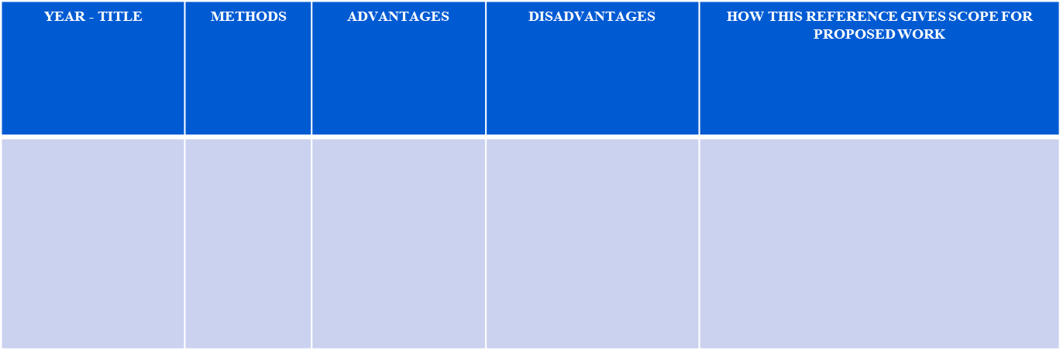
LITERATURE REVIEW
2020
Recognizing action units for facial expression analysis
Facial Action Coding System (FACS) for portraying outward appearances by activity units (AUs).
AUs are anatomically identified with the withdrawals of explicit facial muscles: 12 are for upper face, and 18 are for lower face
mix doesn't change the presence of the constituent AUs
AUs that they characterized, 30 AUs are anatomically identified with the withdrawals of explicit facial muscles: 12 are for upper face, and 18 are for lower face.

Slide 8
LITERATURE REVIEW
2022
Constants across societies in the face and feeling.
Accuracy and Objectivity
Real-time analysis
Privacy concern
Data leak
Ongoing investigations indicating that individuals from educated societies connected a similar feeling ideas with a similar facial practices couldn't exhibit that probably some outward appearances of feeling are all inclusive
Attention Mechanisms

Slide 9
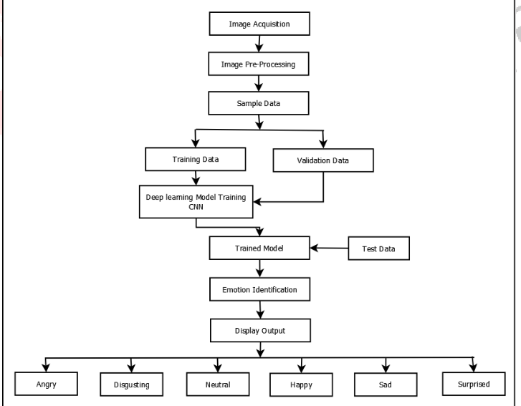
ARCHITECTURE DIAGRAM - DFD
DEPARTMENT OF CSE
DEPARTMENT OF INFOATION TECHNOLOGY

Slide 10
ALGORITHM
Input: An image or video of a customer's face in a restaurant
Output: A feedback score based on the customer's facial expression
Step 1: Detect and locate the face from the image or video using Haar-AdaBoost algorithm
Step 2: Extract and classify the facial features and emotions using a pre-trained CNN model
Step 3: Assign and aggregate feedback scores based on the detected emotions and their frequencies using a rule-based algorithm
Step 4: Return the feedback score as the output
DEPARTMENT OF CSE
DEPARTMENT OF INFORMATION TECHNOLOGY

Slide 11
MODULES
Face Detection: Face detection or localization is an important step for image classification since only the principal component of face such as nose, eyes, mouth are needed for classification. Face detection algorithms can be broadly classified into feature, knowledge, template and appearance based methods. Our proposed system uses Viola Jones object detection algorithm for face localization which comes under feature based classification. Viola Jones object detection. algorithm uses Haar feature based cascade classifiers.
Facial Expression Recognition classification: After learning the deep features, the final step of FER (Facial Expression Recognition) is to classify the given face into one of the basic emotion categories. Unlike the traditional methods, where the feature extraction step and the feature classification step are independent, deep networks can perform FER in an end-to-end way. Specifically, a loss layer is added to the end of the network to regulate the back-propagation error, then, the prediction probability of each sample can be directly output by the network.
Convolutional neural network (CNN):CNN has been extensively used in diverse computer vision applications, including FER. At the beginning of the 21st century, several studies in the FER literature found that the CNN is robust to face location changes and scale variations and behaves better than the multilayer perceptron (MLP) in the case of previously unseen face pose variations, employed the CNN to address the problems of subject independence as well as translation, rotation, and scale invariance in the recognition of facial expressions.
DEPARTMENT OF CSE
DEPARTMENT OF INFORMATION TECHNOLOGY

Slide 12
REFERENCES
1. Darwin C, Prodger P. The expression of the emotions inman and animals. Oxford University Press, USA, 2020.
2. Tian YI, Kanade T, Cohn JF. Recognizing action unitsfor facial expression analysis, IEEE Transactions on pattern analysis and machine intelligence. 2023;23(2):97-115.
3. Ekman P, Friesen WV. Constants across cultures in the face and emotion.” Journal of personality and social psychology. 2020; 17(2):124-129.
4. Ekman P. Strong evidence for universals in facial expressions: a reply to russell’s mistaken critique,
Psychological bulletin. 2021; 115(2)268–287.
DEPARTMENT OF CSE
DEPARTMENT OF INFORMATION TECHNOLOGY

Slide 13
THANK YOU

